Slide 1
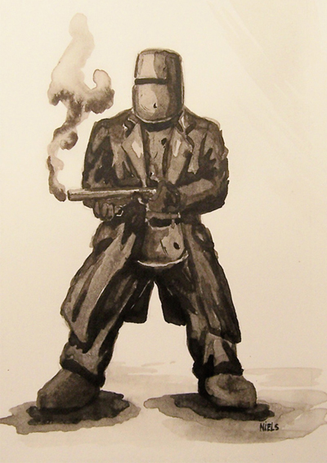
Bushrangers

Slide 2
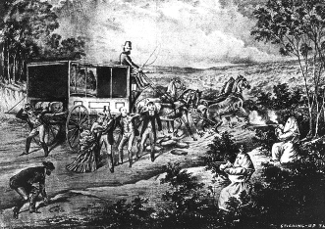
What are Bushrangers?
Bushrangers were robbers who lived in the bush. They committed crimes such as stealing sheep, cattle, horses, food. They also committed highway robbery.

Slide 3
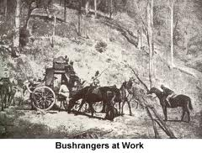
The first bushrangers?
Australia was originally a place where England sent their convicts. The first bushrangers were convicts who ran away so they didn’t have to serve their punishment.

Slide 4
Why did other people become bushrangers?
When gold was discovered in Australia more people became bushrangers.
Some people became bushrangers because they were not successful at digging for gold or they took the opportunity to steal from people who had found gold.
Others did it because they felt that society had treated them badly and they didn’t respect the law.
Some bushrangers even claimed to be modern Robin Hoods.

Slide 5
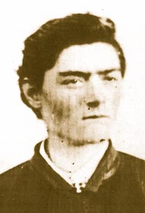
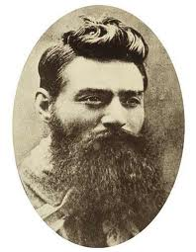
Who was Ned Kelly?
Ned Kelly is the most famous Australian Bushranger. He was born in 1855.
When he was young he got into a lot of trouble with the police. He went to jail when he was 15 because of a stolen horse which he said he didn’t know was stolen, he had got it from a friend.
When he got out of jail he stole horses with his step father.

Slide 6
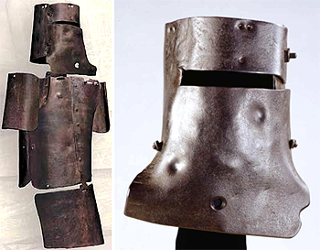
In 1878 police try to arrest Dan, Ned’s brother. The policeman claimed that Ned shot him. After this Ned, Dan and two of their friends went into hiding in the bush. They were known as the Kelly gang.
The Kelly gang robbed banks and stole large amounts of money, they also made armour out of metal to protect themselves.

Slide 7
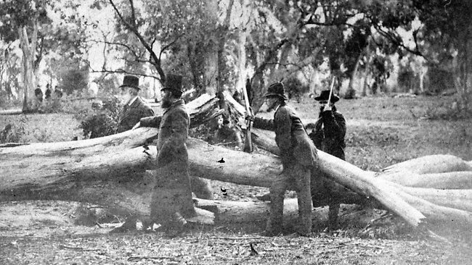
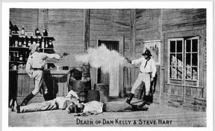
On June 27th 1880 the Kelly gang took over the town of Glenrowan. There was a large battle with the police. Finally they were corned in the Glenrowan Inn and Ned was captured after he was shot in the legs.

Slide 8
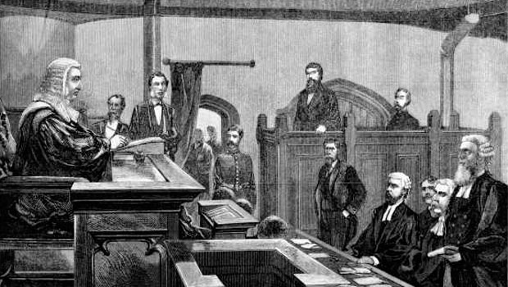
Ned Kelly was sentenced to death at his trial and was hung on November 11th 1880. His brother and friends died in the battle.

